Slide 1

Clothing store
Project with structures

Slide 2
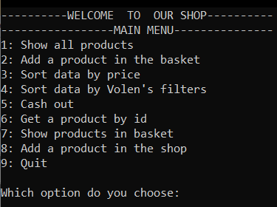
Why did we choose this topic?
We wanted to make it easier for the small clothing stores which don’t have their websites and don’t have this type of organization.

Slide 3
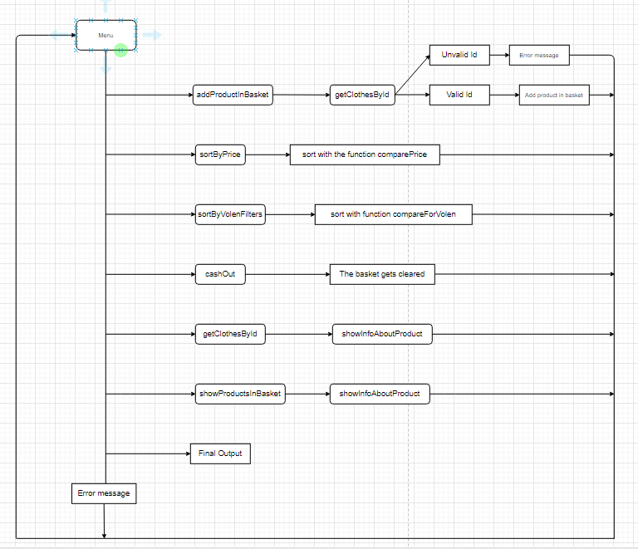

C
Diagram describing menus

Slide 4
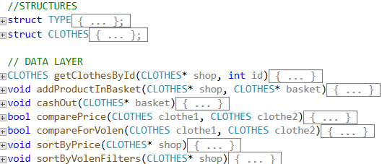
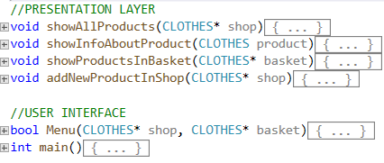
The functions that we used
Data layer
Presentation layer

Slide 5




Used technologies
C

Slide 6
NOW it's time for our program

Slide 7

Thank you for the attention
C
asslavov18@codingburgas.bg
RVVelichkova18@codingburgas.bg
VPMateev18@codingburgas.bg
SRNikolov18@codingburgas.bg

